Slide 1
Publisher-Subscriber Model
Software Analysis and Design
CSE 460
H.S. Sarjoughian
School of Computing, Informatics, and Decision Systems Engineering
Fulton Schools of Engineering
Arizona State University, Tempe, AZ, USA

Slide 2
Software Engineering Process
Does not consider architecture/design patterns
Requirement /Analysis
Design
Problem Statement
Implementation
Testing
Requirements/Analysis
Architecture/Design Patterns
Design
Approach to be used
Considers architecture

Slide 3
Applicability
The software system has two aspects where one is dependent on another
Change in one object can result in any number of other objects to change
An object is responsible for notifying any number of other objects
Some objects are interested in receiving notifications

Slide 4
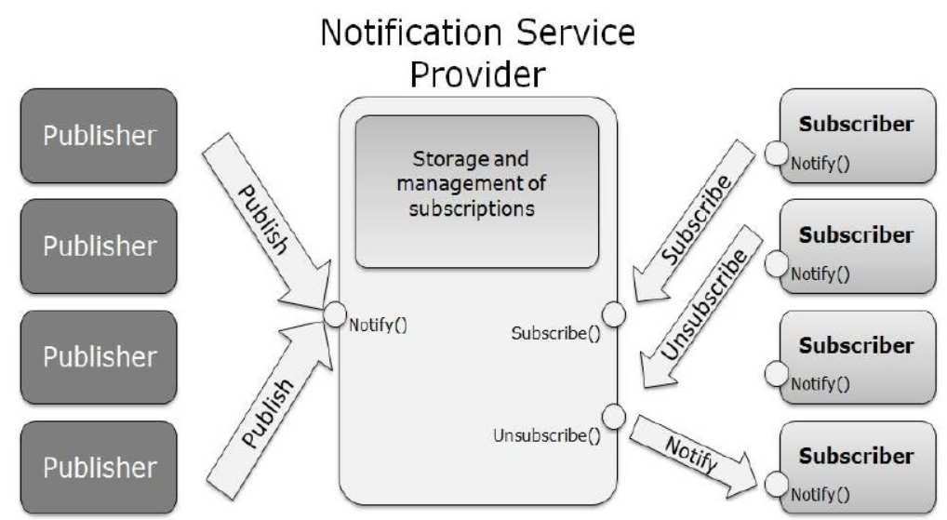
Structure and Participants
Credit: Reference [3]

Slide 5
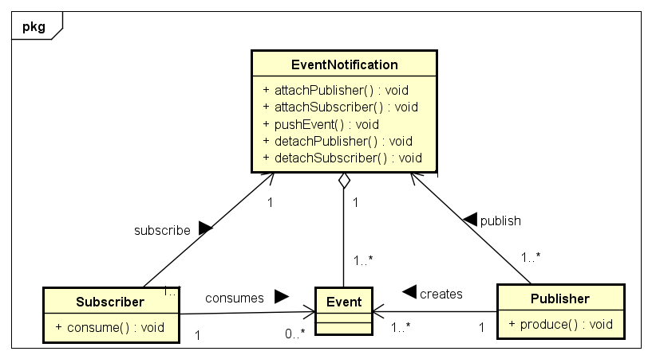
Structure and Participants
Details of the methods (e.g., visibility, return type, and arguments) need to be specified for classes

Slide 6
Publisher-Subscriber Design Pattern Example
Event bus
subscribe port
subscribed events
published events
publish port
LIT
CSE
Subscriber 1
GEO
LIT
Publisher 1
PHY
PHY
Subscriber 2
CSE
MAT
Publisher 2
BIO
MUS
Publisher 3
listen port
announce port
Event pool
CSE
GEO
LIT
…
Lists possible events that may be published or subscribed to
Assumptions:
Each component can be either publisher or subscriber
Events (from both publisher and subscriber) are independent and totally-ordered
Number of publishers, subscribers, and events are arbitrary

Slide 7
Publish-Subscribe Design Pattern Example (cont.)
Event bus
subscribe port
subscribed events
published events
publish port
LIT
CSE
Subscriber 1
GEO
LIT
Publisher 1
PHY
PHY
Subscriber 2
CSE
MAT
Publisher 2
BIO
BIO
MUS
Publisher 3
listen port
announce port
Event pool
CSE
GEO
LIT
…
Lists possible events that may be published or subscribed to

Slide 8
Consequences and Known Uses
Advantages
Modularity: publishers and subscribers are unaware of each other (publishers and subscribers can vary independently)
Extensibility: scalable (publishers and subscribers are simpler to add and remove)
Customizability: subscribers can do different things
Disadvantages
Subscribers and publishers may affect the overall system in undesirable ways since subscribers (and publishers) don’t know anything about their siblings.
Some uses
Publishers/subscriber middleware
Cloud software systems (e.g., Dropbox)

Slide 9
References
[1] Pattern-Oriented Software Architecture, Volume 4, A Pattern Language for Distributed Computing, F. Buschmann, K. Henney, D. C. Schmidt, Wiely, 2007
[2] Ishraq Fataftah, 2012. “Publish Subscribe model overview” Available at: http://www.slideshare.net/ishraqabd/publish-subscribe-model-overview-13368808
[3] Software Architecture in Practice, 3rd Edition, (SAP3), Bass, L. Clements, P., and Kazman, R., Addison Wesley, SEI Series in Software Engineering, 2012

